Slide 1

CDACL-002-Customer Segmentation
Khush Panchal
Data Analyst

Slide 2

Agenda
Project Objective
Dataset Overview
Data Cleaning & Preparation
Exploratory Data Analysis (EDA)
Discount Strategy Analysis
Customer Segmentation (Clustering)
Marketing Strategy Recommendations
Final Business Recommendations

Slide 3

Project Overview
The objective of this project is to analyze customer purchase behavior, identify optimal discount strategies, and segment customers into meaningful groups for targeted marketing.

Slide 4
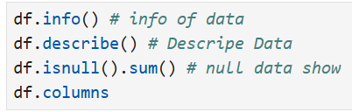
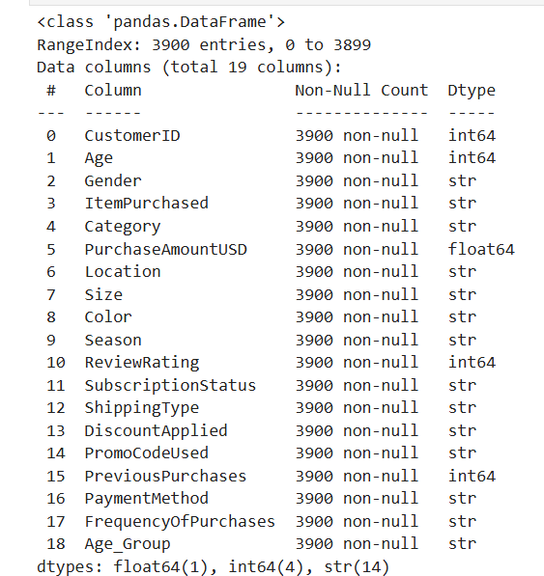
Dataset Overview
1.
Total Records: 3900
Total Features: 19
No Missing Values
Variables: Age, Category, Season, Payment Method, etc.

Slide 5
Datasets & Tools Used
Dataset Details
Dataset Name: Customer Shopping Trends Dataset
Total Records: 3,900
Total Features: 19
Data Type: Structured (Tabular Data)
Tools & Technologies Used
Programming & Analysis
Python
Pandas (Data Manipulation)
NumPy (Numerical Analysis)
Matplotlib (Visualization)
Scikit-Learn (K-Means Clustering)
Database
MySQL Workbench (Data Extraction)
Visualization & Reporting
Power BI
PowerPoint (Presentation & Reporting)

Slide 6
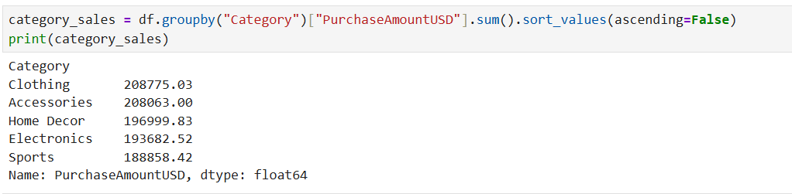
Category Wise Sales Analysis
Clothing and Accessories generate the highest revenue, while Sports and Electronics show relatively lower revenue contribution.

Slide 7
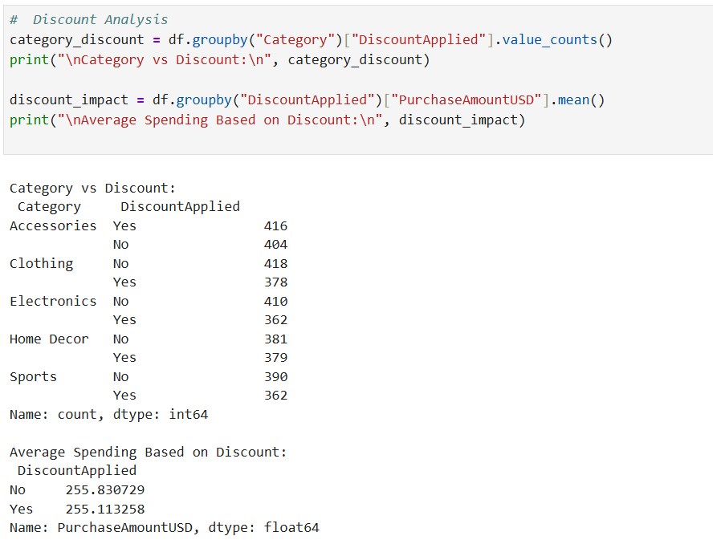
Discount Penetration Analysis
Electronics and Sports categories have lower discount penetration, presenting an opportunity for promotional campaigns.

Slide 8
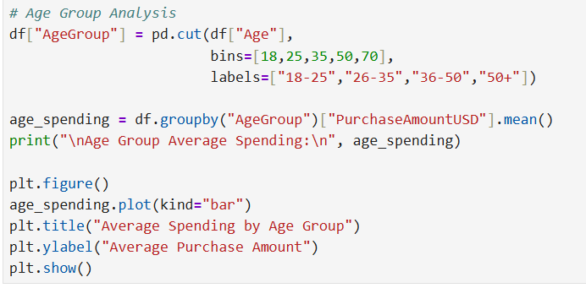
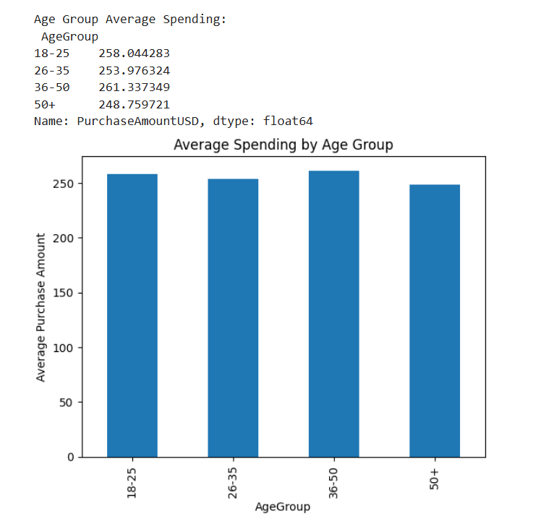
Age Group Spending Analysis
Customers aged 36–50 demonstrate the highest average spending, indicating strong purchasing power in this segment.

Slide 9
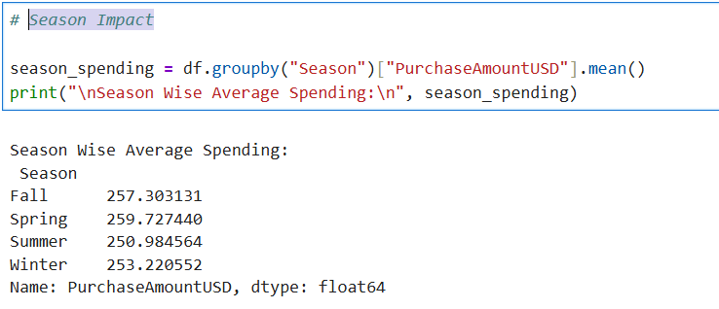
Season Impact

Slide 10
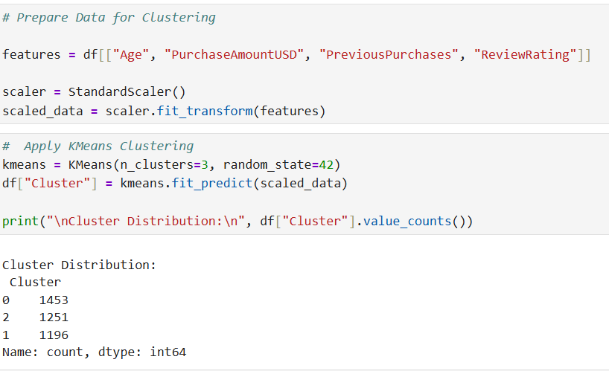
Clustering Methodology
K-Means clustering was applied using Age, Purchase Amount, Previous Purchases, and Review Rating to identify customer segments.

Slide 11
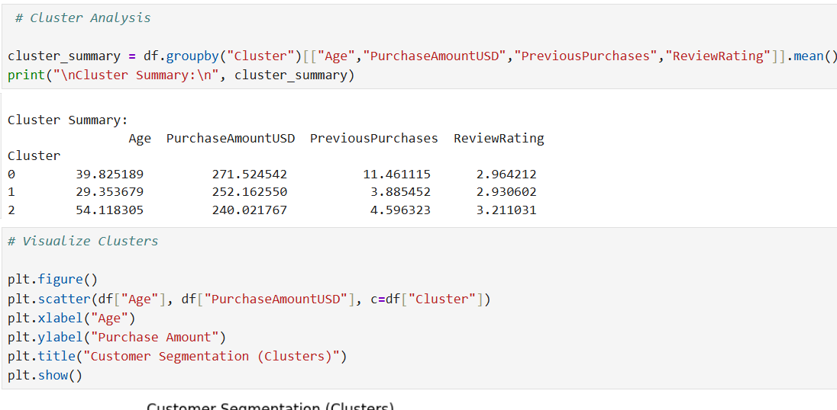
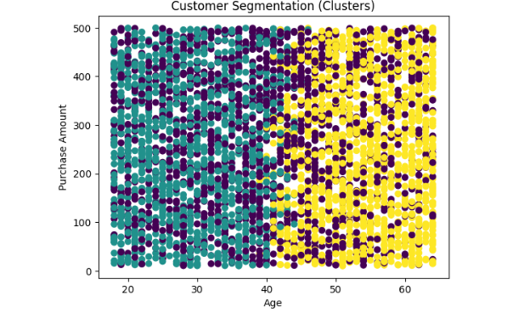
Cluster Profiles

Slide 12
Customer Cluster Profiles
Cluster 0 – High Value Customers
(Highest Purchase Amount + Highest Previous Purchases)
Avg Age: ~40 years
Highest Avg Purchase Amount (~271 USD)
Highest Previous Purchases (~11 transactions)
Moderate review rating
🎯 Business Meaning:
This segment represents loyal and high-spending customers.
💡 Strategy:
Loyalty programs
Exclusive premium offers
Early access to new products
Cluster 1 – Regular Buyers
Avg Age: ~29 years
Medium Purchase Amount (~252 USD)
Low Previous Purchases (~3 transactions)
Moderate review rating
🎯 Business Meaning:
Young customers with consistent but moderate spending behavior.
💡 Strategy:
Seasonal promotions
Bundle offers
Student/young professional discounts
Cluster 2 – Mature Low-Spend Segment
Avg Age: ~54 years
Lowest Purchase Amount (~240 USD)
Moderate previous purchases
Slightly higher review rating
🎯 Business Meaning:
Older demographic with lower spending intensity.
💡 Strategy:
Targeted discount coupons
Personalized recommendations
Retention campaigns
Three distinct customer segments were identified, enabling targeted marketing strategies to maximize revenue and customer retention

Slide 13
SQL Implementation

Slide 14
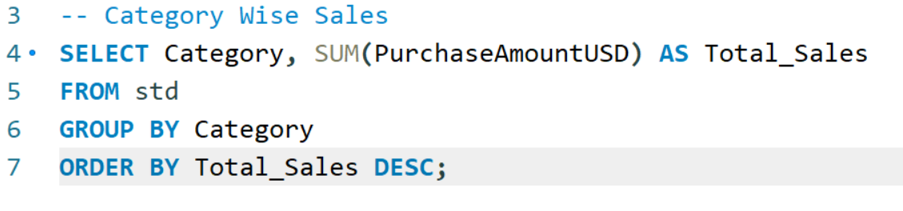
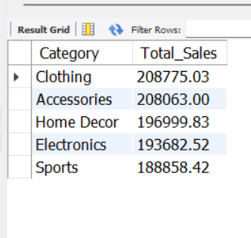
Category Wise Sales

Slide 15
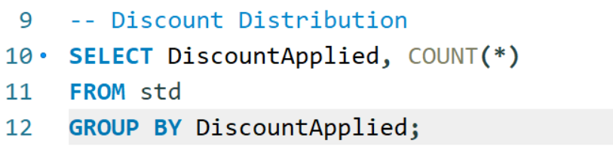
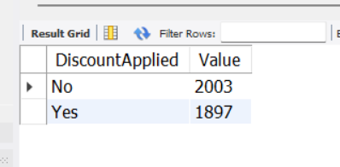
Discount Distribution

Slide 16
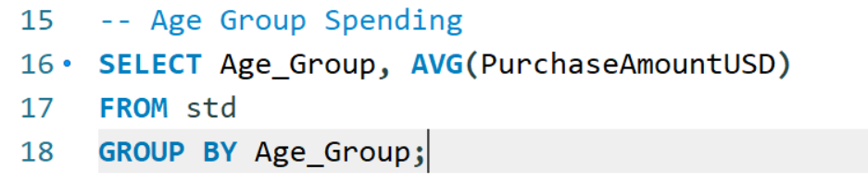
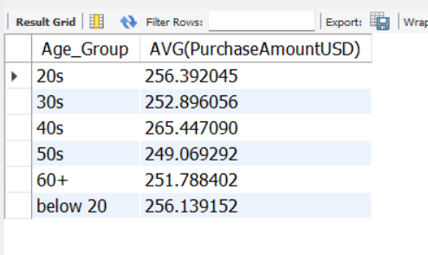
Age Group Spending
SQL was used for structured data extraction and preliminary aggregation before advanced analysis in Python.

Slide 17
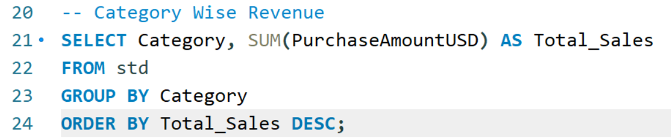
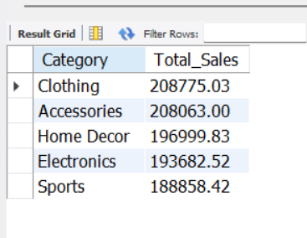
Category Wise Revenue

Slide 18
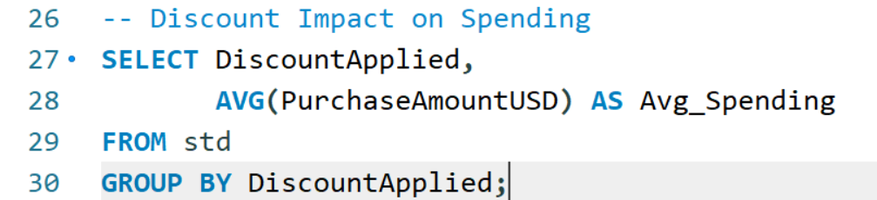
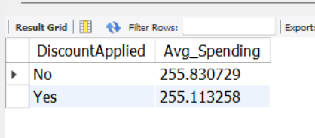
Discount Impact on Spending

Slide 19
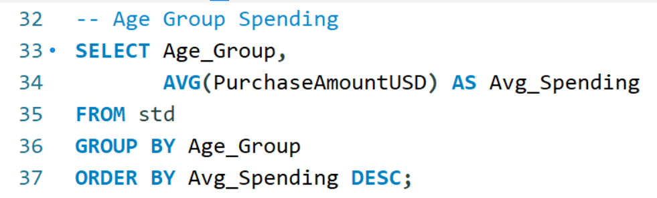
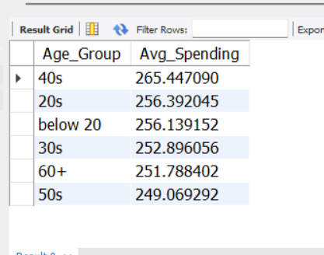
Age Group Spending

Slide 20
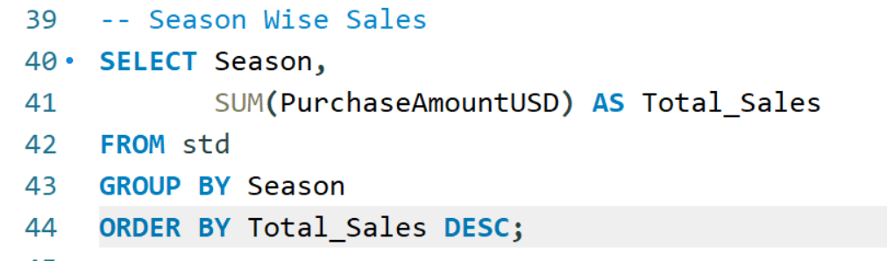
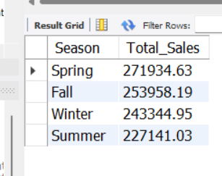
Season Wise Sales

Slide 21
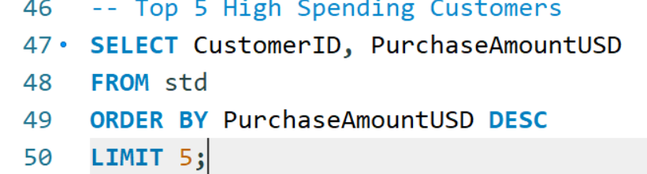
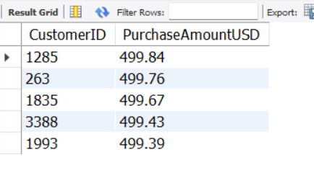
Top 5 High Spending Customers

Slide 22
Power BI Implementation

Slide 23
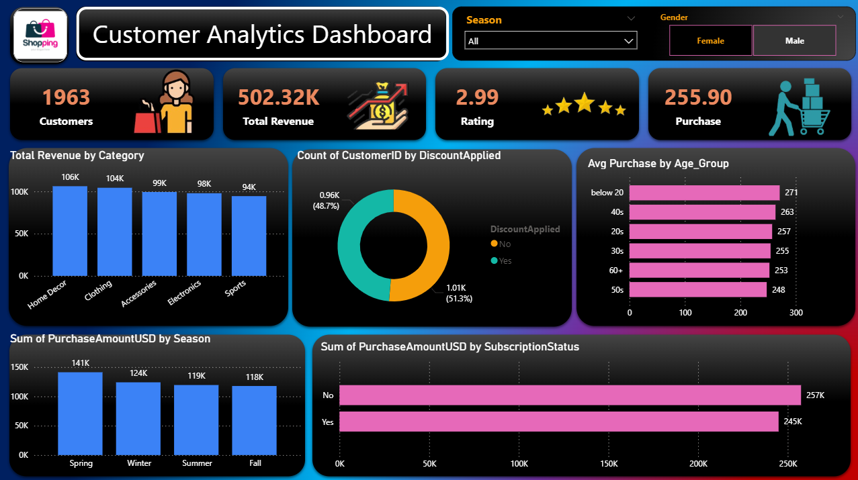
Customer Analytics

Slide 24
Customer Performance Dashboard – Key Insights
🔹 Revenue Performance
Total Revenue generated: $502K
Strong revenue contribution from Home Decor and Clothing
Revenue distribution across categories is balanced, reducing dependency risk
🔹 Customer Spending Behavior
Average purchase value: $255
Highest average spending observed in Below 20 and 40s age segments
Indicates strong spending power in younger and mid-age customers
🔹 Seasonal Trends
Spring season shows highest revenue ($141K)
Winter and Summer show slightly lower but stable demand
Business shows healthy seasonal consistency
🔹 Subscription Impact
Revenue from non-subscribers slightly higher than subscribers
Indicates opportunity to improve subscription conversion strategy
🔹 Discount Impact
51% purchases include discount usage
Discount dependency is moderate — room to optimize pricing strategy

Slide 25
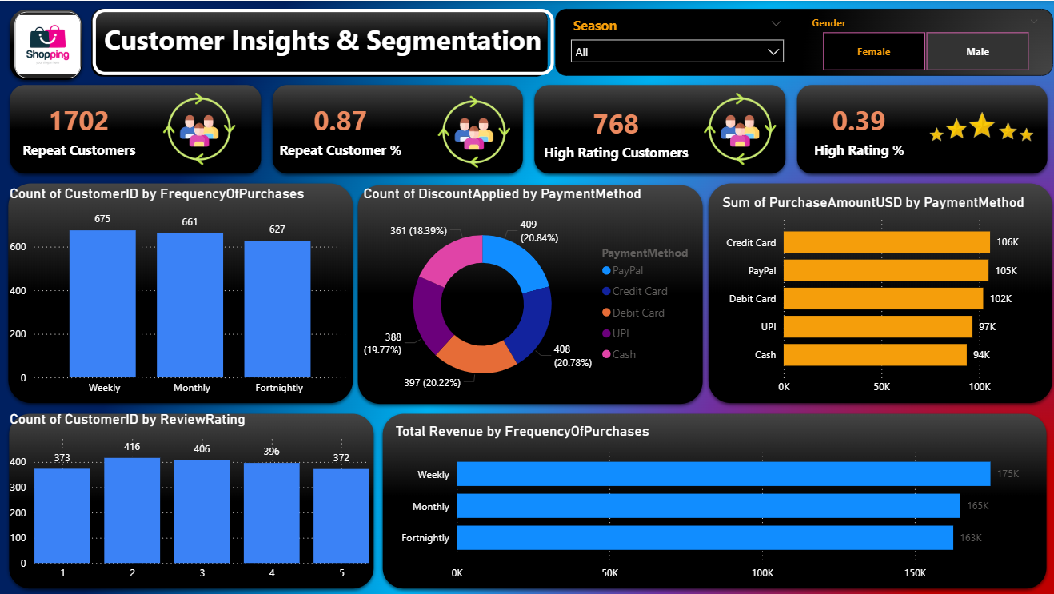
Customer Insights & Segmentation – Key Findings

Slide 26
Customer Insights & Segmentation – Key Findings
🔹 Customer Retention
Repeat Customers: 1702
Repeat Customer Rate: 87%
Strong customer retention observed
🔹 Customer Satisfaction
High Rating Customers: 768
High Rating Percentage: 39%
Majority ratings concentrated between 3–4
Opportunity to improve service quality to increase 4–5 ratings
🔹 Purchase Frequency Analysis
Weekly customers generate highest revenue ($175K)
Monthly customers follow closely
Frequent buyers contribute major share of revenue
🔹 Payment Method Preference
Credit Card & PayPal generate highest revenue
Cash & UPI slightly lower
Digital payment adoption is strong

Slide 27
Business Recommendations
Short-Term Strategies (0–6 Months)
1 Targeted Discount Campaigns
Apply strategic discounts in Electronics and Sports categories
Use limited-time promo codes to boost demand
2 Segment-Based Promotions
Offer loyalty rewards to High Value Customers (Cluster 0)
Provide seasonal offers to Regular Buyers
3 Age-Focused Marketing
Target 36–50 age group with premium product campaigns
Use digital ads tailored to young (26–35) customers
4 Bundle & Cross-Selling
Combine high-performing categories (Clothing + Accessories)
Promote combo deals to increase cart value

Slide 28
Business Recommendations
Long-Term Strategies (6–24 Months)
1️⃣ Loyalty & Retention Program
Introduce tier-based membership (Silver / Gold / Platinum)
Reward repeat purchases with points system
2️⃣ Personalized Marketing Engine
Use clustering model for automated targeted campaigns
Send personalized email/SMS offers
3️⃣ Predictive Analytics Implementation
Implement churn prediction models
Forecast seasonal demand trends
4️⃣ Data-Driven Pricing Optimization
Analyze discount elasticity
Optimize pricing for low-performing categories
By leveraging customer segmentation and data-driven discount optimization, the company can improve revenue growth, enhance customer retention, and strengthen long-term market positioning.

